Slide 1
JNCIS-ENT
Protocol Independent Routing

Slide 2
Static, Aggregate and Generated Routes
1
Administratively configured routing

Slide 3
What is a static route?
A manually defined route within the routing table
The routing table is also referred to as the Routing Information Base (RIB)
Static routes have a default preference of 5
Static routes consist of a destination and a valid next-hop
lab@SW1> show route protocol static
inet.0: 3 destinations, 3 routes (3 active, 0 holddown, 0 hidden)
+ = Active Route, - = Last Active, * = Both
192.168.10.0/24 *[Static/5] 00:00:19
> to 192.168.2.1 via ge-0/0/0.0

Slide 4
Configuring static routes
lab@SW1> show route protocol static
inet.0: 3 destinations, 4 routes (3 active, 0 holddown, 0 hidden)
+ = Active Route, - = Last Active, * = Both
192.168.10.0/24 *[Static/5] 00:08:56
> to 192.168.2.1 via ge-0/0/0.0
[Static/7] 00:00:02
> to 192.168.2.2 via ge-0/0/0.0
inet6.0: 1 destinations, 1 routes (1 active, 0 holddown, 0 hidden)
lab@SW1> show configuration routing-options
static {
route 192.168.10.0/24 {
next-hop 192.168.2.1;
qualified-next-hop 192.168.2.2 {
preference 7;
}
}
}

Slide 5
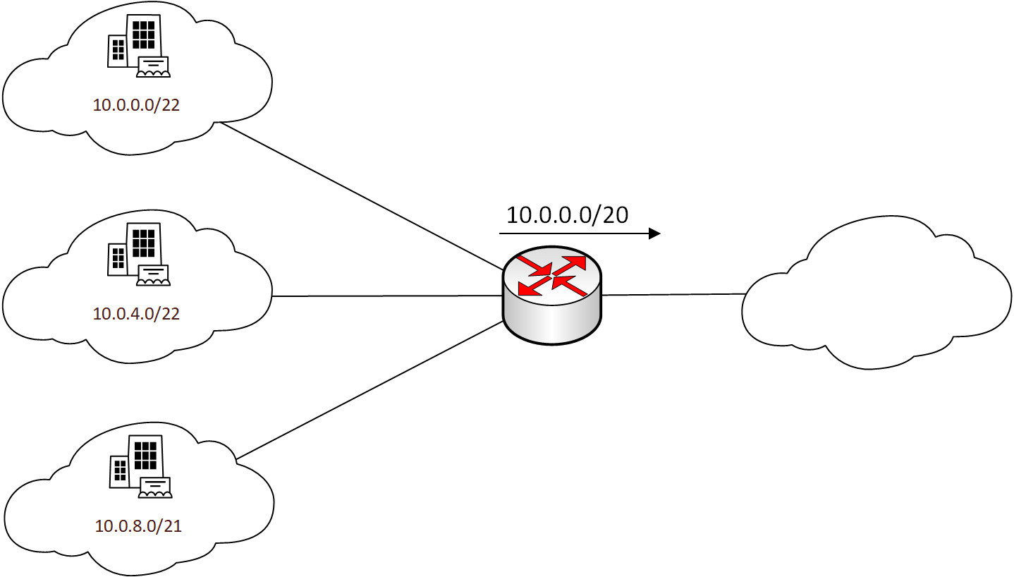
Aggregate Routes
Aggregate routes are administratively defined routes which are a composite of more specific routes
At least one contributing route must be present in the RT for the aggregate route to be active
The default preference of aggregate routes is 130

Slide 6
Configuring Aggregate Routes
lab@SW1> show configuration routing-options
aggregate {
route 10.22.33.0/24 community 1:555;
}
lab@SW1> show route
inet.0: 5 destinations, 6 routes (5 active, 0 holddown, 0 hidden)
+ = Active Route, - = Last Active, * = Both
10.22.33.0/24 *[Aggregate/130] 00:04:41
Reject

Slide 7
Monitoring Aggregate Routes
lab@SW1> show route exact 10.22.33.0/24 detail
inet.0: 5 destinations, 6 routes (5 active, 0 holddown, 0 hidden)
10.22.33.0/24 (1 entry, 1 announced)
*Aggregate Preference: 130
Next hop type: Reject, Next hop index: 0
Address: 0xc28f208
Next-hop reference count: 2
State: <Active Int Ext>
Age: 6:16
Validation State: unverified
Task: Aggregate
Announcement bits (1): 0-KRT
AS path: I (LocalAgg)
Flags: Depth: 0 Active
AS path list:
AS path: I Refcount: 1
Contributing Routes (1):
10.22.33.1/32 proto Direct

Slide 8

Generated Routes
Generated routes are much like aggregate routes in that they are only present when more specific contributing routes are present
A key difference is that the next-hop of a generated route is the next-hop of the key contributing route, not reject
Contributing routes cannot be directly attached routes, they must be static or learned via another protocol

Slide 9
Configuring Generated Routes
lab@SW1> show configuration routing-options
static {
route 192.168.10.0/24 {
next-hop 192.168.2.1;
qualified-next-hop 192.168.2.2 {
preference 7;
}
}
}
generate {
route 192.168.10.0/23;
}
lab@SW1> show route 192.168.10.0/23 exact
inet.0: 5 destinations, 6 routes (5 active, 0 holddown, 0 hidden)
+ = Active Route, - = Last Active, * = Both
192.168.10.0/23 *[Aggregate/130] 00:04:11
> to 192.168.2.1 via ge-0/0/0.0

Slide 10
Monitoring Generated Routes
lab@SW1> show route 192.168.10.0/23 exact detail
inet.0: 5 destinations, 6 routes (5 active, 0 holddown, 0 hidden)
192.168.10.0/23 (1 entry, 1 announced)
*Aggregate Preference: 130
Next hop type: Router, Next hop index: 564
Address: 0xc28fa3c
Next-hop reference count: 5
Next hop: 192.168.2.1 via ge-0/0/0.0, selected
Session Id: 0x0
State: <Active Int Ext>
Age: 5:51
Validation State: unverified
Task: Aggregate
Announcement bits (1): 0-KRT
AS path: I
Flags: Generate Depth: 0 Active
Contributing Routes (1):
192.168.10.0/24 proto Static

